Slide 1
The Male Reproductive System

Slide 2
Male Reproductive System
External
Scrotum
Penis
Glans Penis
Foreskin
Internal
Testes
Epididymis
Vas Deferens
Seminal Vesicle
Ejaculatory Duct
Prostate Gland
Cowper’s Glands

Slide 3
Male Reproductive System
Scrotum: external sac that contains testes
Penis: organ of copulation; cylindrical shape composed of erectile tissue that encloses the urethra
Glans Penis: enlarged tip of the penis
Foreskin: covers the glans penis; removed if circumcision occurs

Slide 4
Male Reproductive System
Testes: primary male reproductive organ; sperm produced here in the seminiferous tubules
Epididymis: coiled tube that lies over testis; stores sperm
Vas Deferens: tube upward of epididymis; extend over top and down posterior of bladder where it meets the seminal vesicle; carries sperm
Seminal Vesicle: produces 60% of ejaculatory fluid

Slide 5
Male Reproductive System
Ejaculatory Duct: formed by union of epididymis and seminal vesicle
Prostate Gland: fused to base of bladder; ejaculatory duct passes through adding an alkaline substance that is 30% of seminal fluid
Cowper’s (Bulbourethral) Glands: Two pea-shaped glands below prostate; connect to urethra; provide alkaline fluid necessary for sperm viability
Urethra: expels semen and urine; bladder sphincter closes during ejaculation to keep urine from expelled and to keep sperm out of bladder

Slide 6
Diseases and disorders of the Male Reproductive System - Penis
Priapism – an erection lasting longer than 4 hrs. Treatment: ice to the groin and increased physical activity
Erectile dysfunction (ED)- inability to achieve or sustain an erection during sexual intercourse. Treatments: based on the cause. Could be psychological, urological or both.

Slide 7
Diseases and disorders of the Male Reproductive System - Penis
Some experts warn that ED may be a risk factor for heart disease, if atherosclerosis is present.
Balanitis – inflammation of the glans of the penis. If a male is uncircumcised, hygiene of the foreskin is essential. Treatment: based on cause, topical antibiotics
Phimosis – common in children. Tighten of the foreskin that does no allow retraction. Treatment: steroid application or small incision

Slide 8
Diseases and disorders of the Male Reproductive System - Testes
Testicular trauma – usually caused by a direct blow. Treatment: based on cause. Interruption in the integrity of the structures require emergent interventions.
Testicular Cancer – treatments include Excision of the testis/Radiation/Chemo

Slide 9
Diseases and disorders of the Male Reproductive System - Testes
Testicular torsion - twisting of spermatic cord- common in 12-18 year olds. Can occur post-trauma, after intense exercise or without reason. Treatment: manual distortion, emergency surgery is the most common.
Epididymitis – inflammation of the tubes on the testis. Commonly caused by bacterial infection; sexually transmitted disease. Treatment: based on cause; usually antibiotics

Slide 10
Diseases and disorders of the Male Reproductive System - Prostate
Prostatitis – inflammation of the prostate gland. Caused by bacterial infection, nervous system disorder, irritation of the gland itself i.e. Foley catheter insertion. Treatment: antibiotics, alpha blockers (for relaxation of the bladder), pain relievers, massage.
Benign prostatic hypertrophy/enlargement of the prostate (BPH) – not due to infection. Common in men over 50 yrs. Treatment: IVP and/or TURP.

Slide 11
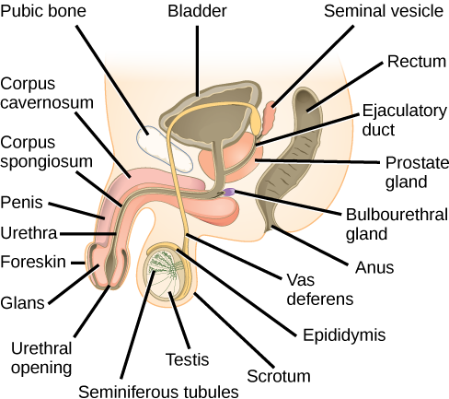
Internal/External Anatomy
Side view:

